Slide 1
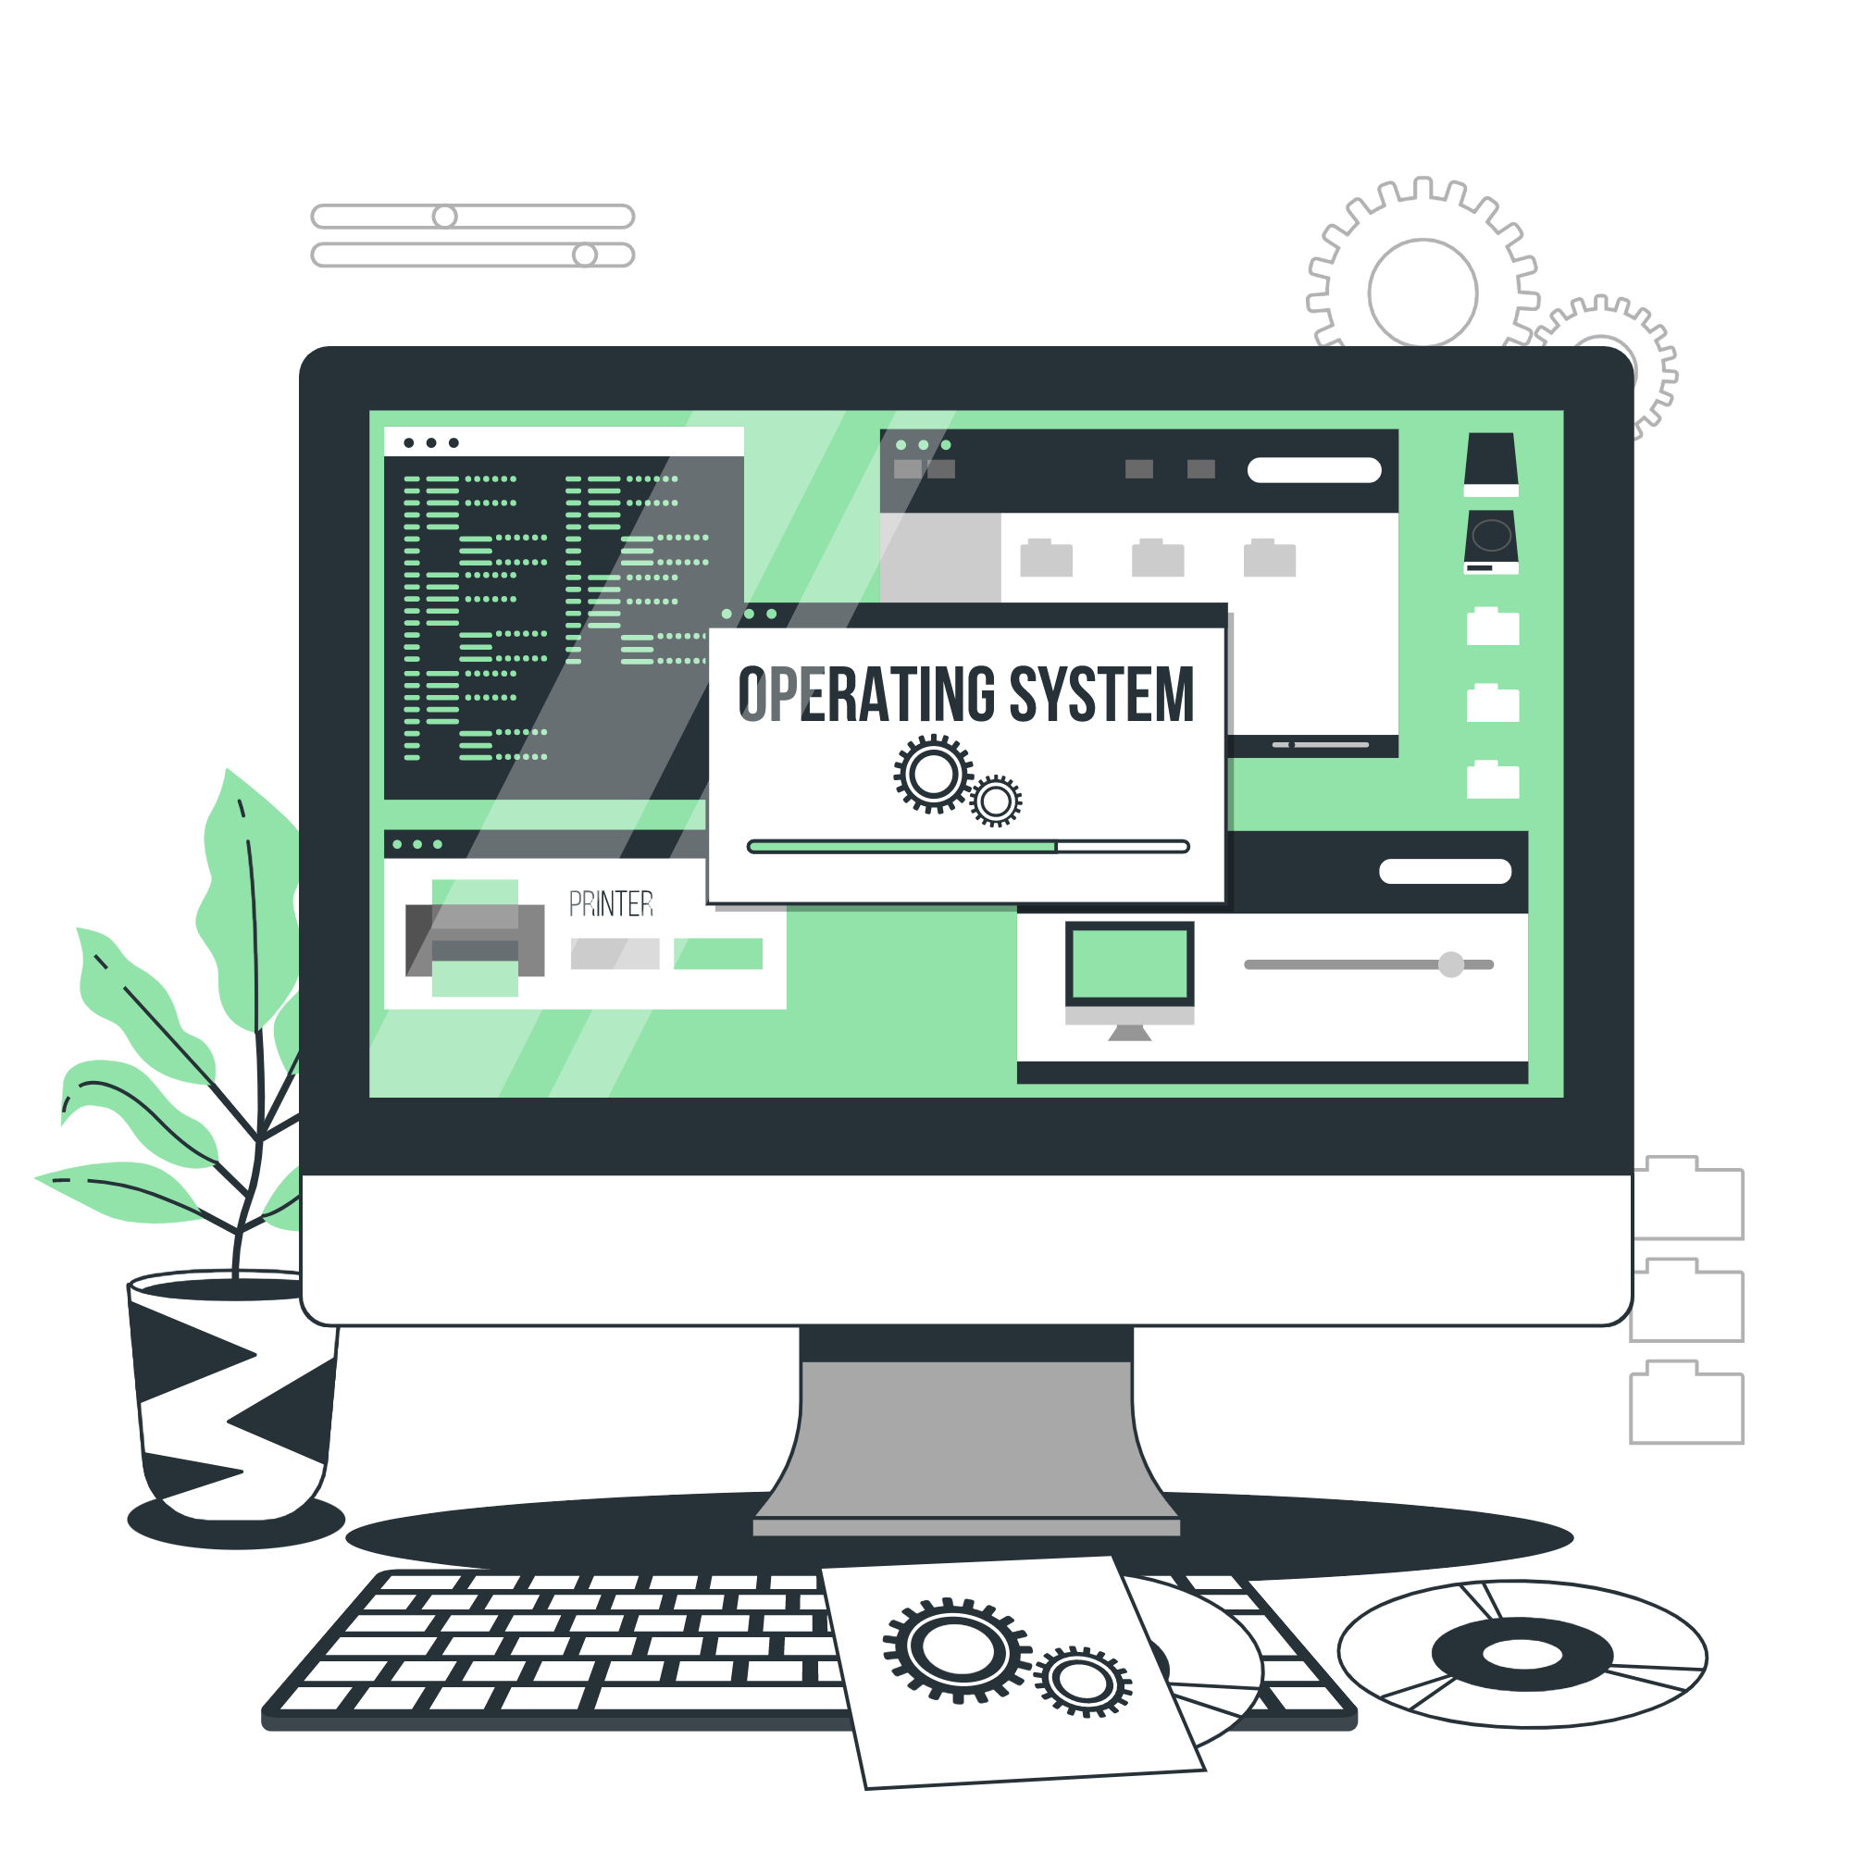
Operating Systems
Lecture : 14

Slide 2

Identify and use system utilities/tools and evaluate the results

Slide 3
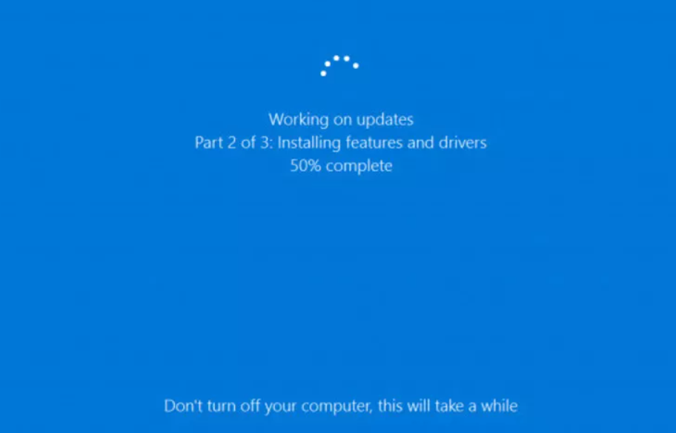
Avoiding inconvenient software update reboots
Windows 10 is, in many ways, a truly internet-based operating system. Mostly, this is a bonus but there are times when it isn't – and Microsoft's attitude towards operating system updates is one such time.
The most annoying part of automatic updates in the Windows 10 is the restarting, which can seemingly come at random (and inconvenient times).
The simplest way to counteract this is to head to Windows Update (in Settings > Update & Security), click on Advanced Options and then Notify to Schedule Restart, which means the OS will request a reboot instead of interrupting everything you’re working on.

Slide 4
Set auto login to avoid typing in passwords endlessly
Want to dodge the lock screen login in Windows 10? There is one easy way to do this – first of all, you’ll need to bring up the Run command box.
To do so, click on the Cortana/search box (next to the Start menu) and simply type in the following:
netplwiz
You’ll see a User Accounts window appear, and here, you need to select the account that will automatically login. Type in the credentials for this account and hit OK.
A new window, called Automatically Sign-in, will subsequently appear. Type your password again and hit OK. Go to Sign-in options, select 'Never' under the ‘Require Sign-in’ box, then hit OK one final time.

Slide 5
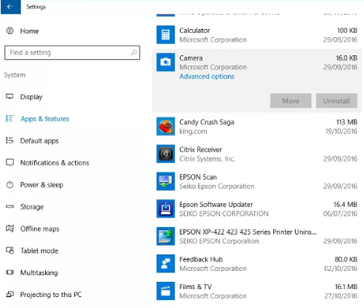
Moving apps to a different drive in Windows 10
You can move apps to a different drive by heading to Start > Settings > System. Next, locate the Apps & Features section. In here, if you click on a program you’ll see a Move button for those apps which can be moved.
Select Move and Windows will produce a set of available locations you can shift the program to. Choose which one is best and select it; Windows will do the rest.

Slide 6
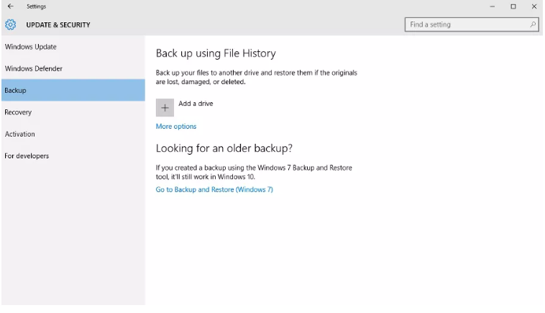
Backing up a Windows 10 PC
Windows 10 has many of the same backup features that were present on Windows 7, accessed by going into Settings > Update & Security > Backup.
The options include adding another drive to backup to, or accessing a previous backup on another machine – you can restore from a backup you created using Windows 7, in fact.
OneDrive is also a quick and easy option for backing up files, providing an off-site alternative in case of fire or theft. You'll find OneDrive under File Explorer (which in turn is under the Start menu)

Slide 7
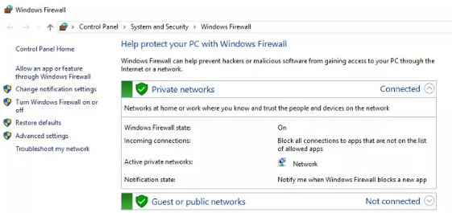
Protecting your PC with Windows Firewall
Windows Firewall can be configured as incredibly strong via the 'Advanced Settings' option – i.e. it blocks all suspect apps without asking – or slightly weaker, which means there's a slightly greater risk that your PC will become hit with some kind of infection, but the firewall won't interfere as much.
The easiest way to find out which settings are best for you is to simply test things out for a few days and tweak as needed.
If you forget what you've done in the settings or think you've messed things up, just click on Restore Default Policy on the right-hand side of the Advanced Settings menu to get things back to normal.

Slide 8
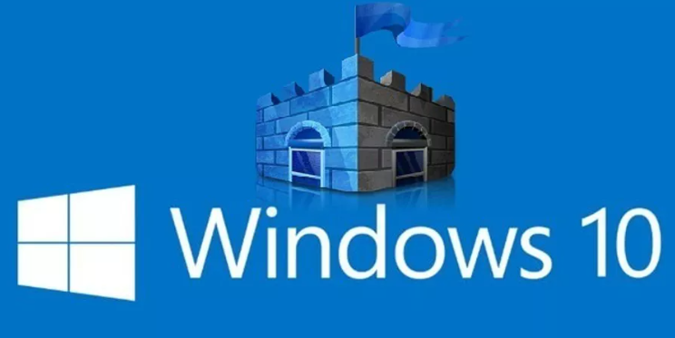
Benefiting from Windows Defender
You'll find it under Settings > Update & Security, and then click on Windows Defender. It's a must that real-time protection should be turned on to allow Windows to constantly monitor for anything suspicious and step in should a detection occur.
if you have a third-party antivirus application installed, Windows Defender will be turned off so as to avoid conflicts.

Slide 9
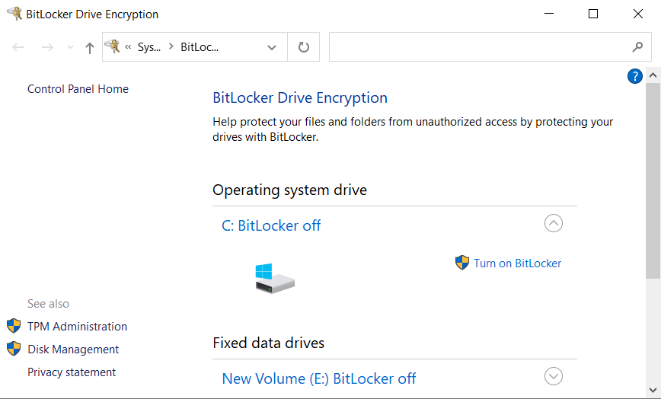
Setting up device encryption
To enable device encryption, go to Start, search 'encryption' and select Change device encryption settings.
After that, select Manage BitLocker and turn it on, then follow the subsequent instructions. With your data encrypted, if hackers do manage to somehow access it, the information won't be of any use to them.
The only downside is that performance may take a bit of a hit on older machines, but if you need peace of mind regarding your precious data, it's worth it.

Slide 10
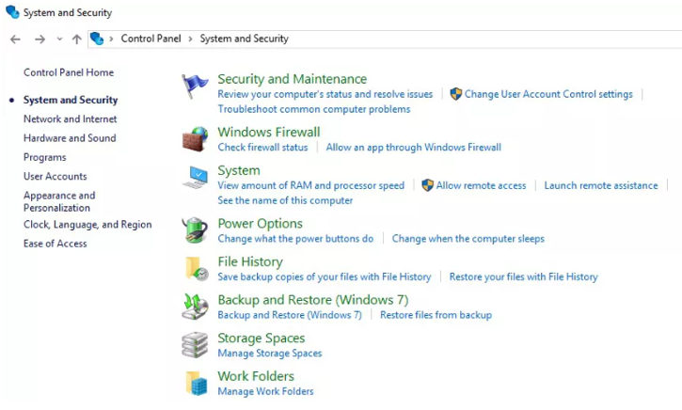
Revert to previous versions of files
To do this, right click the Start button, and then select Control Panel > System and Security > File History, and then click ‘Restore personal files’ in the left panel.
You’ll be presented with all the files that have been saved by File History, with each version present as far back as it ‘remembers’. (If File History isn’t turned on, Windows will tell you, and offer up a link to configure it – you can then start using the feature going forward).
Alternatively, to revert specific files, right click on the file in question, head to Properties and select the Previous Versions tab. A list of all the different versions will be there, so simply find the correct one and open it.

Slide 11
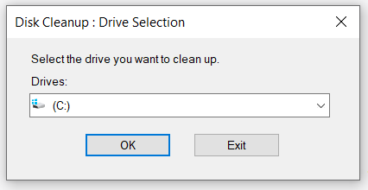
Disk Cleanup in Windows 10
Go to the Start menu and search for "Disk Cleanup".
Select the drive you want to clean up and click "OK".
Check the boxes next to the types of files you want to delete (e.g. Temporary files, Recycle Bin, etc.).
Click "OK" to confirm and delete the selected files.
Evaluate the results: check the amount of disk space that has been freed up.

Slide 12
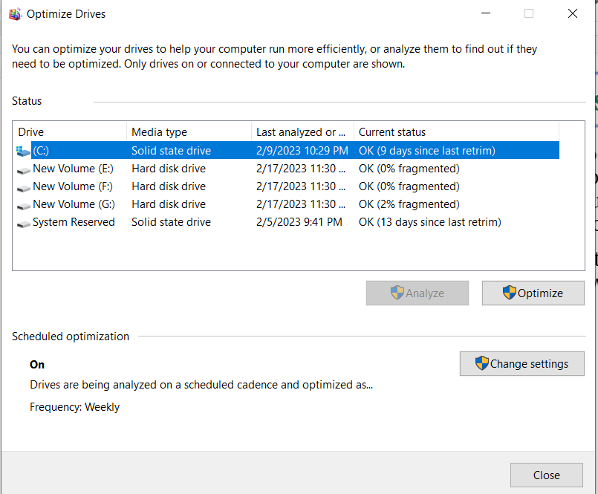
Disk Defragmenter in Windows 10
Go to the Start menu and search for "Defragment and Optimize Drives".
Select the drive you want to defragment and click "Optimize".
Wait for the defragmentation process to complete.
Evaluate the results: check the performance of the drive and compare it to before defragmentation.

Slide 13
System Configuration in Windows 10
Press the Windows key+R to open the Run dialog box.
Type "msconfig" and press Enter to open System Configuration.
Navigate to the "Services" tab to view all of the services that are currently running on your computer.
Navigate to the "Startup" tab to view all of the programs that are set to run at startup.
Uncheck any services or programs that are unnecessary to improve performance.
Evaluate the results: check the performance of your computer after disabling unnecessary services and startup programs.

Slide 14
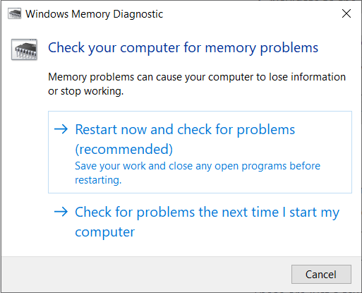
Windows Memory Diagnostic
Go to the Start menu and search for "Windows Memory Diagnostic".
Select "Restart now and check for problems (recommended)".
Wait for the scan to complete.
Evaluate the results: check for any memory errors that are reported by the tool.

Slide 15
Program Threats,
Security Violation Method
Security Attacks,
Security Measure Level

Slide 16
The Security Problem
System secure if resources used and accessed as intended under all circumstances
Unachievable
Intruders (crackers) attempt to breach security
Threat is potential security violation
Attack is attempt to breach security
Attack can be accidental or malicious
Easier to protect against accidental than malicious misuse

Slide 17
Security Violation Categories
Breach of confidentiality
Unauthorized reading of data
Breach of integrity
Unauthorized modification of data
Breach of availability
Unauthorized destruction of data
Theft of service
Unauthorized use of resources
Denial of service (DOS)
Prevention of legitimate use

Slide 18
Security Violation Methods
Masquerading (breach authentication)
Pretending to be an authorized user to escalate privileges
Replay attack
As is or with message modification
Man-in-the-middle attack
Intruder sits in data flow, masquerading as sender to receiver and vice versa

Slide 19
Security Violation Methods
Session hijacking
Intercept an already-established session to bypass authentication
Privilege escalation
Common attack type with access beyond what a user or resource is supposed to have

Slide 20
Security Measure Levels
Impossible to have absolute security, but make cost to perpetrator sufficiently high to deter most intruders
Security must occur at four levels to be effective:
Physical
Data centers, servers, connected terminals
Application
Benign or malicious apps can cause security problems
Operating System
Protection mechanisms, debugging

Slide 21
Security Measure Levels
Network
Intercepted communications, interruption, DOS
Security is as weak as the weakest link in the chain
Humans a risk too via phishing and social-engineering attacks
But can too much security be a problem?

Slide 22

Program Threats
Many variations, many names
Trojan Horse
Code segment that misuses its environment
Exploits mechanisms for allowing programs written by users to be executed by other users
Spyware, pop-up browser windows, covert channels
Up to 80% of spam delivered by spyware-infected systems

Slide 23

Program Threats
Trap Door
Specific user identifier or password that circumvents normal security procedures
Could be included in a compiler

Slide 24
Program Threats
Ransomware
Malware that encrypts the user's data and demands a ransom for the decryption key.
Can result in loss of access to critical data and financial loss if ransom is paid.
Examples include WannaCry, which targeted Windows systems.

Slide 25
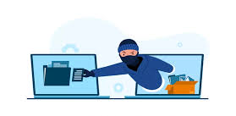
Program Threats
Spyware
Malware that secretly monitors and collects information about a user's activities.
Can lead to privacy breaches and theft of sensitive information.
Examples include Keyloggers that record keystrokes to capture passwords.

Slide 26

Program Threats
Adware
Software that automatically displays or downloads advertising material.
Can be intrusive and degrade system performance.
Pop-up ads and unwanted toolbars in web browsers.

Slide 27
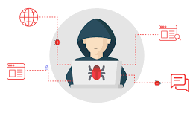
Program Threats
Rootkits
Software that hides the presence of malware by altering the operating system.
Can provide continuous, privileged access to a computer while avoiding detection.
Sony BMG rootkit, which hid DRM software on infected computers.

Slide 28

Program Threats
Backdoors
Methods by which unauthorized users can bypass normal authentication to access a system.
Allows attackers to remotely control and access systems without detection.
Back Orifice, a backdoor trojan used for remote control of a Windows machine.

Slide 29
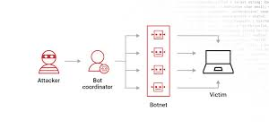
Program Threats
Botnets
Networks of infected computers controlled by a single attacker.
Used to launch large-scale attacks, such as DDoS attacks, or to distribute spam.
The Mirai botnet, which infected IoT devices to perform DDoS attacks.

Slide 30
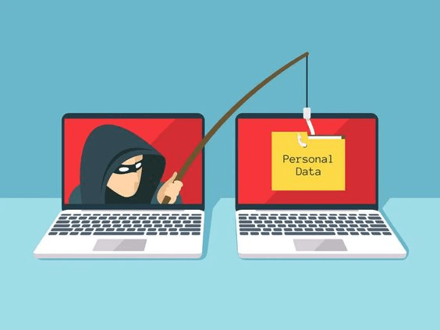
Program Threats
Phishing
Fraudulent attempts to obtain sensitive information by disguising as a trustworthy entity in electronic communications.
Can lead to identity theft and financial loss.
Emails that mimic legitimate institutions requesting personal information.

Slide 31
Program Threats
Malware - Software designed to exploit, disable, or damage computer
Spyware – Program frequently installed with legitimate software to display ads, capture user data
Ransomware – locks up data via encryption, demanding, payment to unlock it
Others include trap doors, logic bombs
All try to violate the Principle of Least Privilege
Goal frequently is to leave behind Remote Access Tool (RAT) for repeated access

Slide 32
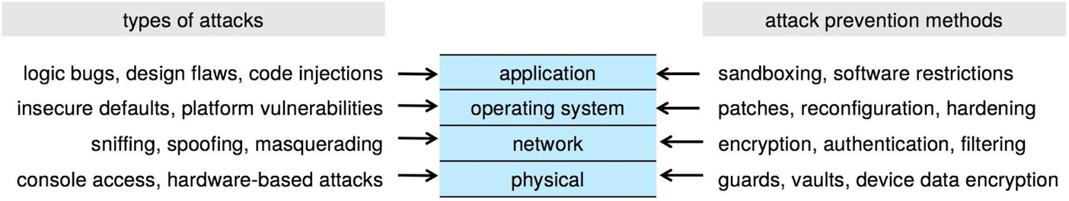
Four-layered Model of Security

Slide 33
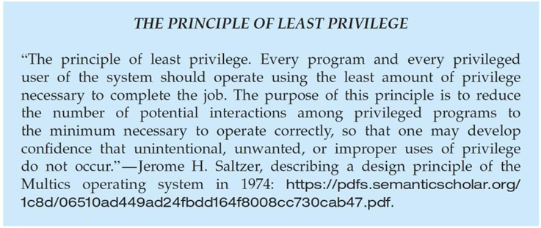
Program Threats

Slide 34
Code Injection
Code-injection attack occurs when system code is not malicious but has bugs allowing executable code to be added or modified
Results from poor or insecure programming paradigms, commonly in low level languages like C or C++ which allow for direct memory access through pointers
Goal is a buffer overflow in which code is placed in a buffer and
execution caused by the attack
Can be run by script kiddies – use tools written but exploit identifiers.

Slide 35
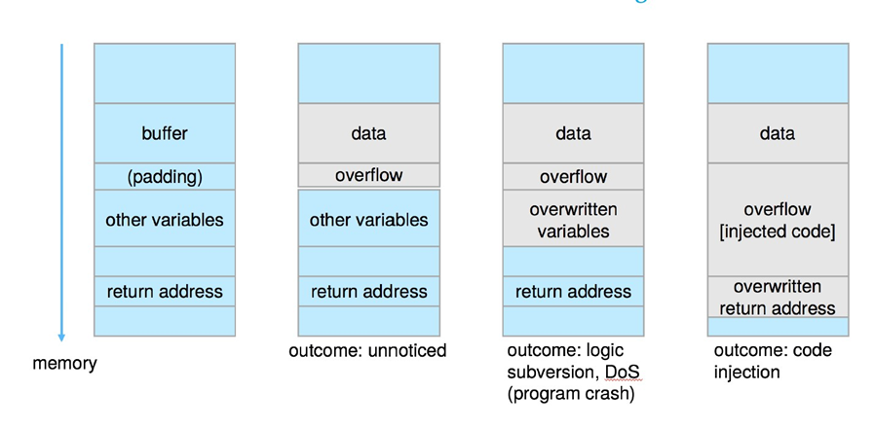
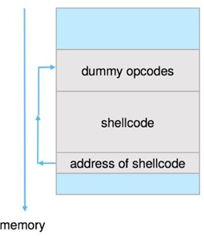
Code Injection
Outcomes from code injection
Frequently use trampoline to code execution to
exploit buffer overflow

Slide 36
Great Programming Required?
For the first step of determining the bug, and second step of writing exploit code, yes
Script kiddies can run pre-written exploit code to attack a given system
Attack code can get a shell with the processes’ owner’s permissions
Or open a network port, delete files, download a program, etc.
Depending on bug, attack can be executed across a network using allowed connections, bypassing firewalls
Buffer overflow can be disabled by disabling stack execution or adding bit to page table to indicate “non-executable” state
Available in SPARC and x86
But still have security exploits

Slide 37
Program Threats
Viruses
Code fragment embedded in legitimate program
Self-replicating, designed to infect other computers
Very specific to CPU architecture, operating system, applications
Usually borne via email or as a macro
Visual Basic Macro to reformat hard drive
Sub AutoOpen()
Dim oFS
Set oFS = CreateObject(’’Scripting.FileSystemObject’’) vs = Shell(’’c:command.com /k format c:’’,vbHide)
End Sub

Slide 38
Program Threats
Virus dropper inserts virus onto the system
Many categories of viruses, literally many thousands of viruses
File / parasitic
Boot / memory
Macro
Source code
Polymorphic to avoid having a virus signature
Encrypted
Stealth
Tunneling
Multipartite

Slide 39
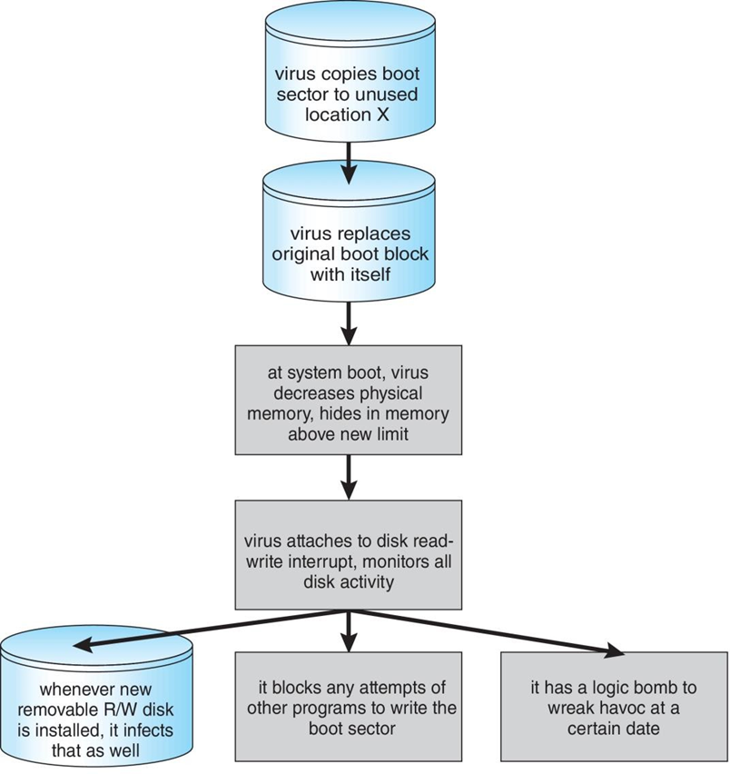
A Boot-sector Computer Virus

Slide 40
The Threat Continues
Attacks still common, still occurring
Attacks moved over time from science experiments to tools of
organized crime
Targeting specific companies
Creating botnets to use as tool for spam and DDOS delivery
Keystroke logger to grab passwords, credit card numbers
Why is Windows the target for most attacks?
Most common
Everyone is an administrator
Licensing required?
Monoculture considered harmful

Slide 41
System and Network Threats
Some systems “open” rather than secure by default
Reduce attack surface
But harder to use, more knowledge needed to administer
Network threats harder to detect, prevent
Protection systems weaker
More difficult to have a shared secret on which to base access
No physical limits once system attached to internet
Or on network with system attached to internet
Even determining location of connecting system difficult
IP address is only knowledge

Slide 42
System and Network Threats
Port scanning
Automated attempt to connect to a range of ports on one or a range of IP addresses
Detection of answering service protocol
Detection of OS and version running on system
nmap scans all ports in a given IP range for a response
nessus has a database of protocols and bugs (and exploits) to apply against a system
Frequently launched from zombie systems
To decrease trace-ability

Slide 43
System and Network Threats
Denial of Service
Overload the targeted computer preventing it from doing any useful work
Distributed Denial-of-Service (DDoS) come from multiple sites at once
Consider the start of the IP-connection handshake (SYN)
How many started-connections can the OS handle?
Consider traffic to a web site
How can you tell the difference between being a target and
being really popular?
Accidental – CS students writing bad fork() code
Purposeful – extortion, punishment

Slide 44
System and Network Threats
Port scanning
Automated tool to look for network ports accepting connections
Used for good and evil

Slide 45
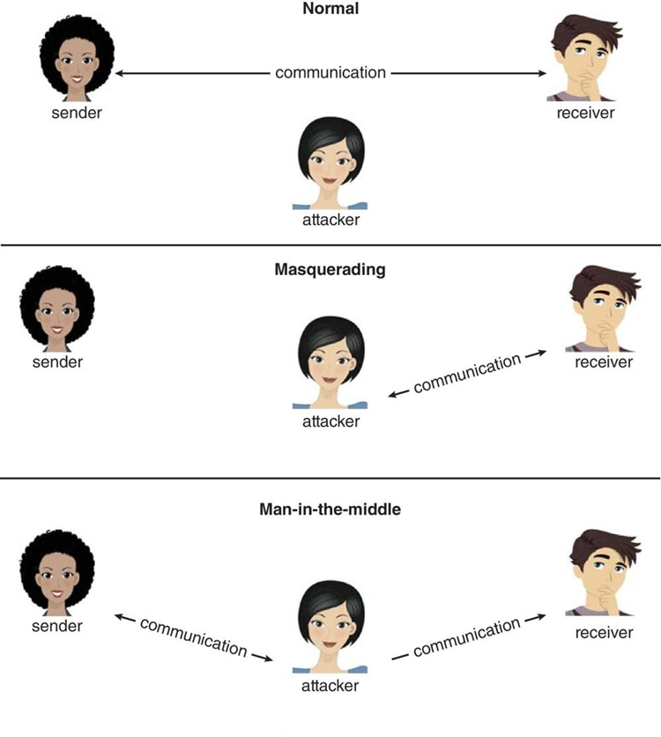
Standard Security Attacks

Slide 46

Let’s do some exercises!

Slide 47
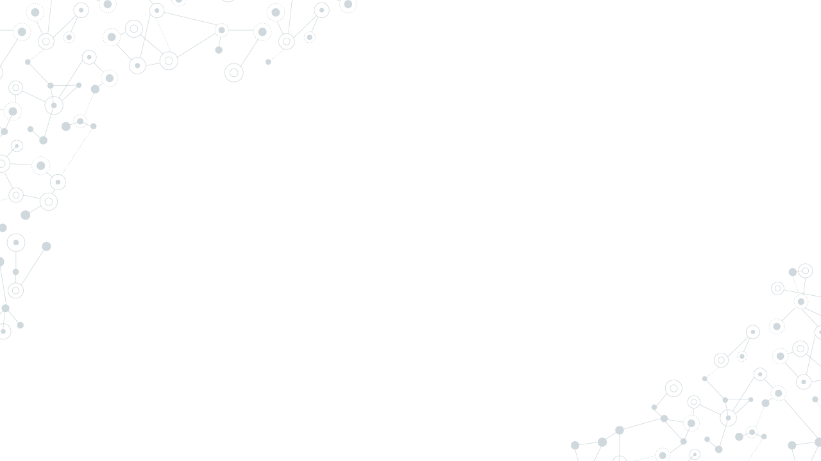
Exercises
Exercise: Disk Cleanup
Open the Disk Cleanup tool on your Windows 10 computer.
Select the C: drive and check the boxes next to "Temporary files" and "Recycle Bin".
Click "OK" to clean up these files.
Evaluate the results and discuss with you friends: How much space did you free up on your computer?
Exercise: Task Manager
Open the Task Manager on your Windows 10 computer.
Navigate to the "Processes" tab and sort the list by CPU usage.
Identify the process that is using the most CPU and end the process.
Evaluate the results and discuss with you friends: Has your computer's performance improved?

Slide 48
Exercises (cont.)
Exercise: System Configuration
Open the System Configuration tool on your Windows 10 computer.
Navigate to the "Services" tab and uncheck the "Print Spooler" service.
Navigate to the "Startup" tab and uncheck the "Spotify" program.
Click "OK" to apply the changes and restart your computer.
Evaluate the results: Has your computer's performance improved?
Exercise: Windows Memory Diagnostic
Open the Windows Memory Diagnostic tool on your Windows 10 computer.
Select "Restart now and check for problems (recommended)".
Wait for the scan to complete and check for any memory errors that are reported.
Evaluate the results: Did the tool detect any memory errors on your computer?

Slide 49
Exercises (cont.)
Exercise: Windows Update
Open the Windows Update tool on your Windows 10 computer.
Check for any available updates and download and install them.
Evaluate the results: Have any performance or security issues been resolved by the updates?
Exercise: System File Checker
Open the Command Prompt tool on your Windows 10 computer.
Type "sfc /scannow" and press Enter to start the System File Checker.
Wait for the scan to complete and check for any corrupted system files that are reported.
Evaluate the results: Were any corrupted system files repaired by the tool?

Slide 50
Exercises (cont.)
Exercise: Disk Check
Open the Command Prompt tool on your Windows 10 computer.
Type "chkdsk C: /f" and press Enter to start the disk check tool.
Wait for the scan to complete and check for any errors that are reported.
Evaluate the results: Were any errors detected and fixed by the tool?
Exercise: Disk Defragmenter
Open the Disk Defragmenter tool on your Windows 10 computer.
Analyze the selected drive for fragmentation.
If fragmentation is detected, click "Optimize" to defragment the drive.
Evaluate the results and discuss with you friends: Has your computer's performance improved?

Slide 51
Exercises (cont.)
Exercise: Event Viewer
Open the Event Viewer tool on your Windows 10 computer.
Navigate to the "Windows Logs" section and click "System".
Look for any red "Error" messages and identify the source of the problem.
Take appropriate action to resolve the problem.
Evaluate the results: Have the error messages been resolved?
Exercise: Device Manager
Open the Device Manager tool on your Windows 10 computer.
Look for any devices with a yellow exclamation mark next to them.
Identify the source of the problem and take appropriate action to resolve it.
Evaluate the results: Have the device issues been resolved?

Slide 52
Exercises (cont.)
Exercise: Disk Management
Open the Disk Management tool on your Windows 10 computer.
Identify any disks or partitions that are not properly configured.
Take appropriate action to reconfigure them, such as creating a new partition or formatting a disk.
Evaluate the results: Have the disk or partition issues been resolved?
Exercise: System Configuration
Open the System Configuration tool on your Windows 10 computer.
Navigate to the "Services" tab and select "Hide all Microsoft services".
Identify any unnecessary services and disable them.
Navigate to the "Startup" tab and disable any unnecessary startup programs.
Evaluate the results and discuss with you friends: Has your computer's performance improved?

Slide 53
Exercises (cont.)
What is safe mode in Windows 10?
Exercise: Accessing Safe Mode
Boot up your Windows 10 computer and access the login screen.
Restart your computer three times in a row to trigger the automatic repair function.
Select "Advanced options" and then "Troubleshoot".
Select "Advanced options" again and then "Startup Settings".
Click "Restart" and choose "Safe Mode" from the list of startup options.
Log in to your computer in Safe Mode.
Evaluate the results: Are you able to access Safe Mode successfully?

Slide 54
Exercises (cont.)
Exercise: Scheduling Updates
Open the Windows 10 "Settings" app and navigate to the "Update & Security" section.
Click on "Advanced options" and then click on "Change active hours".
Set your active hours to a time period when you typically use your computer.
Check the "Automatically adjust active hours for this device" option.
Navigate back to the "Windows Update" section and click on "Pause updates for 7 days".
Repeat this process to extend the pause period if needed.
Evaluate the results and discuss with you friends: Were you able to schedule updates to avoid inconvenient reboots?

Slide 55
Exercises
Identify and describe one example of a man-in-the-middle attack and suggest a countermeasure to prevent it.
List three physical security measures that can protect data centers and explain how each measure contributes to overall security.
Create a simple pseudocode example demonstrating how a buffer overflow can occur in a program.
List and briefly explain two differences between a Trojan Horse and a Virus.
Explain what a replay attack is and provide a real-world scenario where it could be used.

Slide 56

Thanks!

